Slide 1
Scenarios to Practice Using Bogart Annuity Calculator
Exercises based on 2019 as current tax year

Slide 2
Scenario #1 Joint and Survivor Annuity Pension for Martin Bongiovi
Date pension started: 02/01/2014
Joint and Survivor Annuity Pension

Slide 3
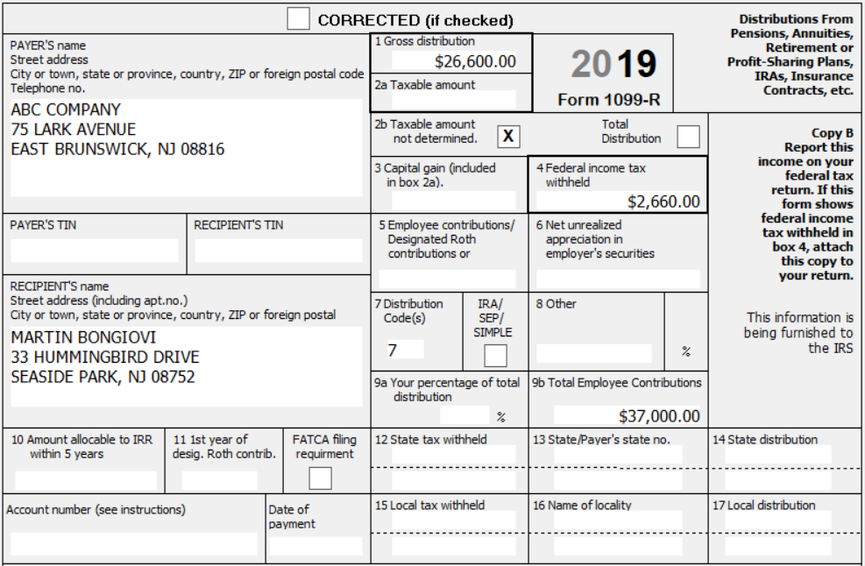
1099-R Joint and Survivor Annuity Pension for Martin Bongiovi

Slide 4
Questions for Scenario #1
How much of Martin’s pension can be excluded from taxation this year?
$1,432
What amount should be entered in 1099-R Box 2a?
$25,168
How much of Martin’s pension contributions have been recovered in prior years?
$7,041

Slide 5
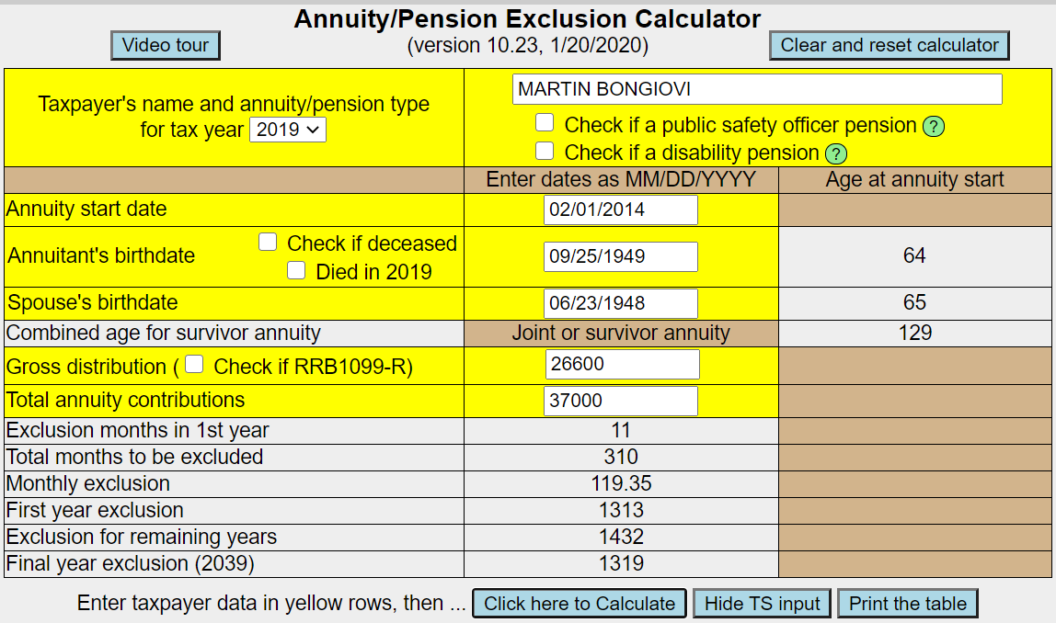
Bogart Annuity Calculator Results for Martin Bongiovi – Part 1

Slide 6
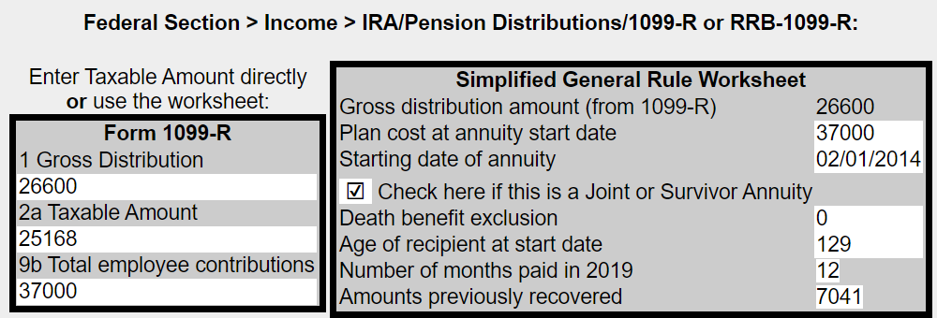
Bogart Annuity Calculator Results for Martin Bongiovi – Part 2

Slide 7
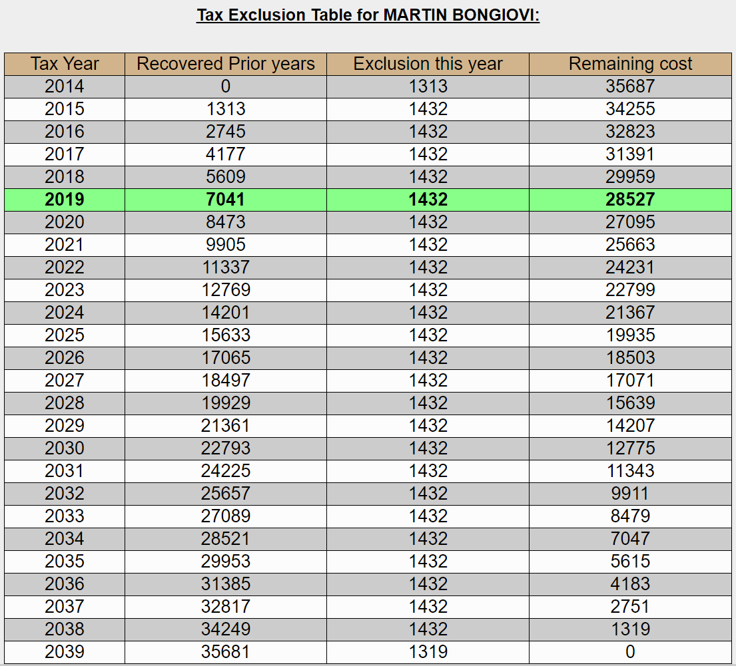
Bogart Annuity Calculator Results for Martin Bongiovi – Part 3

Slide 8
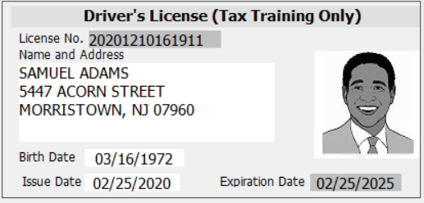
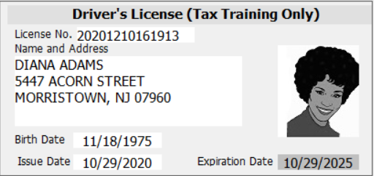
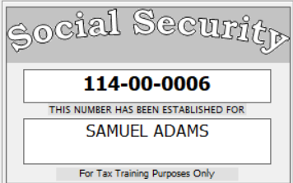
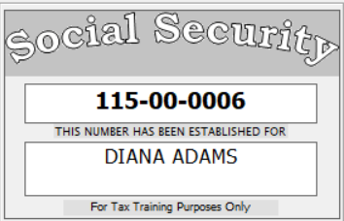
Scenario #2 Disability Pension for Diana Adams
Date disability pension started:
07/01/2016
Employer’s minimum retirement
age: 55

Slide 9
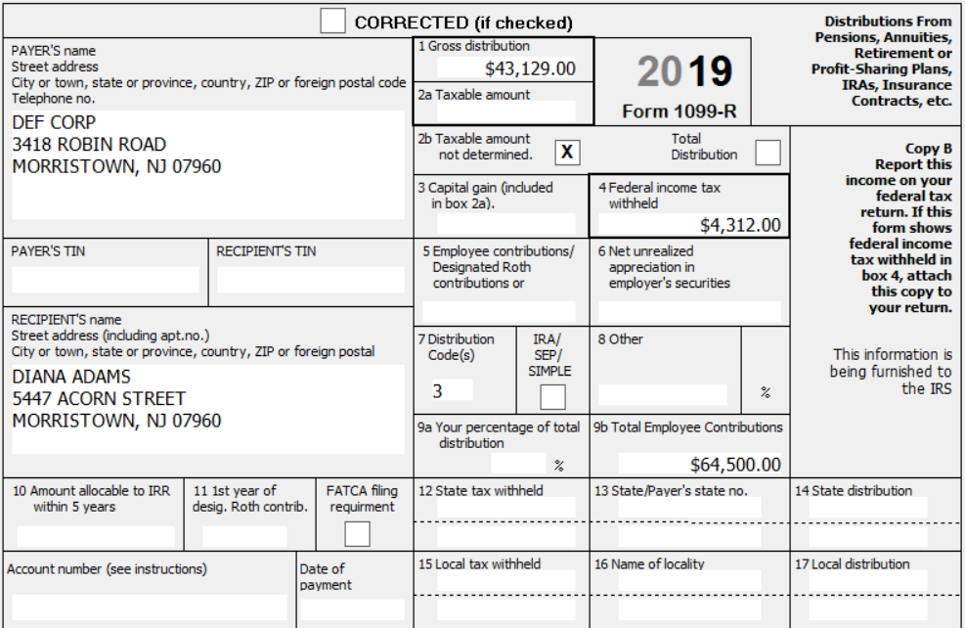
1099-R Disability Pension for Diana Adams

Slide 10
Questions for Scenario #2
How much of Diana’s disability pension is taxable on the Federal return?
$43,129 All of distribution is taxable on Federal return
How much of Diana’s disability pension is taxable on NJ return?
$0 Diana is under age 65 so disability income is not taxable
In what year would Diana start to recover her pension contributions?
2030 Diana Adams will start to recover her pension contributions when she reaches employer’s minimum retirement age. Disability pension will then be treated as a regular pension
On what line of the Federal 1040 will Diana’s disability income be shown?
1040 Line 1 as wages

Slide 11
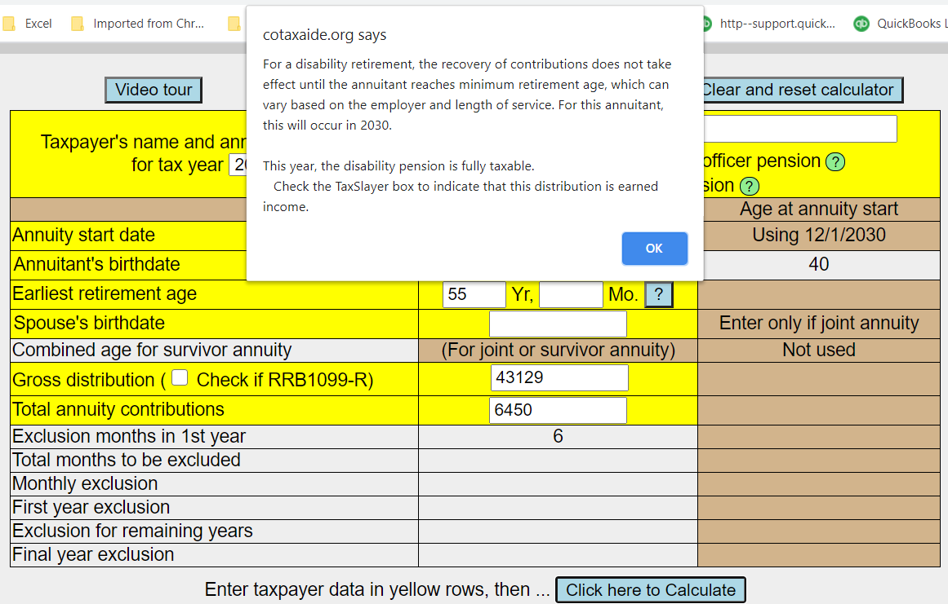
Bogart Annuity Calculator Results for Scenario #2

Slide 12
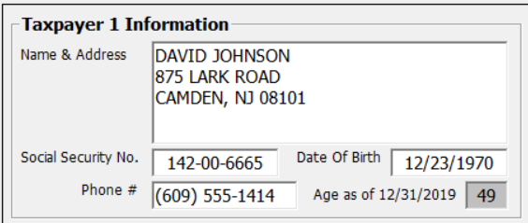
Scenario #3 PSO Pension for David Johnson
Date pension started: 08/01/2017
PSO Health Insurance premiums in
1099-R Box 5 $4,000

Slide 13
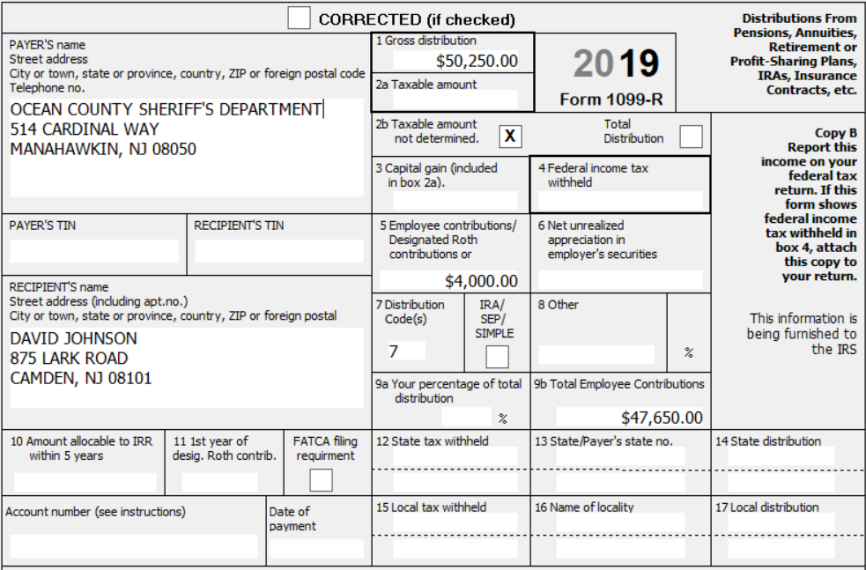
1099-R PSO Pension for David Johnson

Slide 14
Questions for Scenario #3
How much of David’s pension contributions can be excluded from taxation this year?
$1,588
How much of the PSO health insurance premiums can be excluded from the Taxable Amount in Box 2a?
$3,000
Can you claim the other $1,000 of PSO health insurance premiums?
Yes, on Schedule A (subject to the 7.5% threshold)
What amount should be entered in 1099-R Box 2a?
$45,662

Slide 15
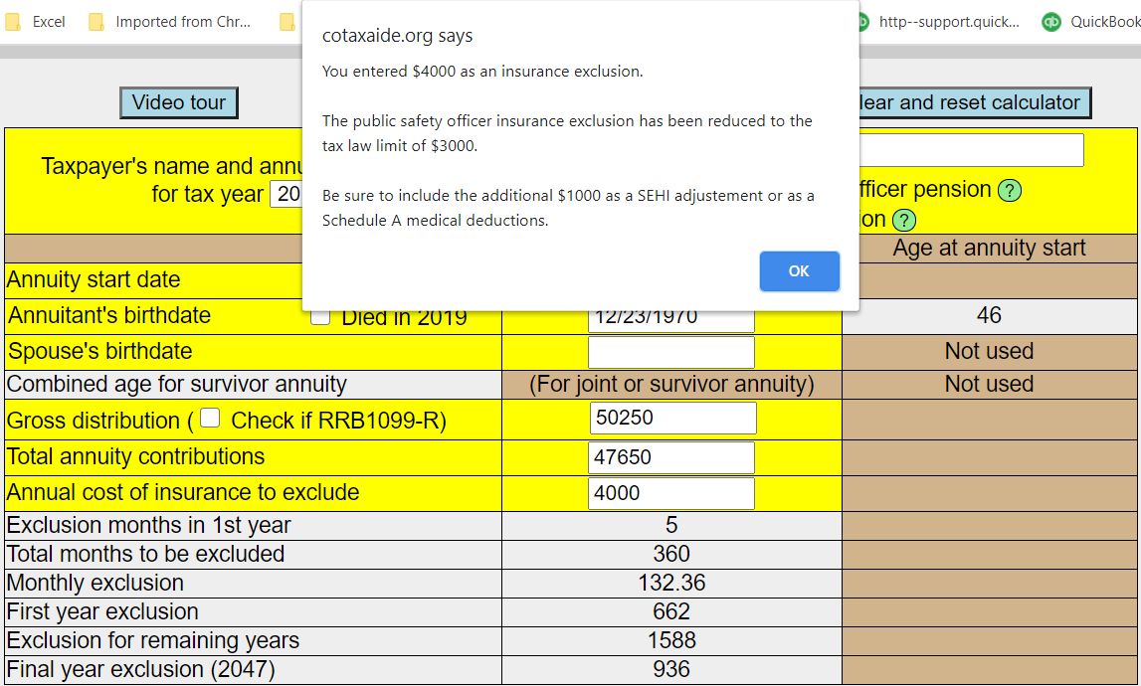
Bogart Annuity Calculator Results for David Johnson - Entering $4,000 as PSO Health Insurance Premiums

Slide 16
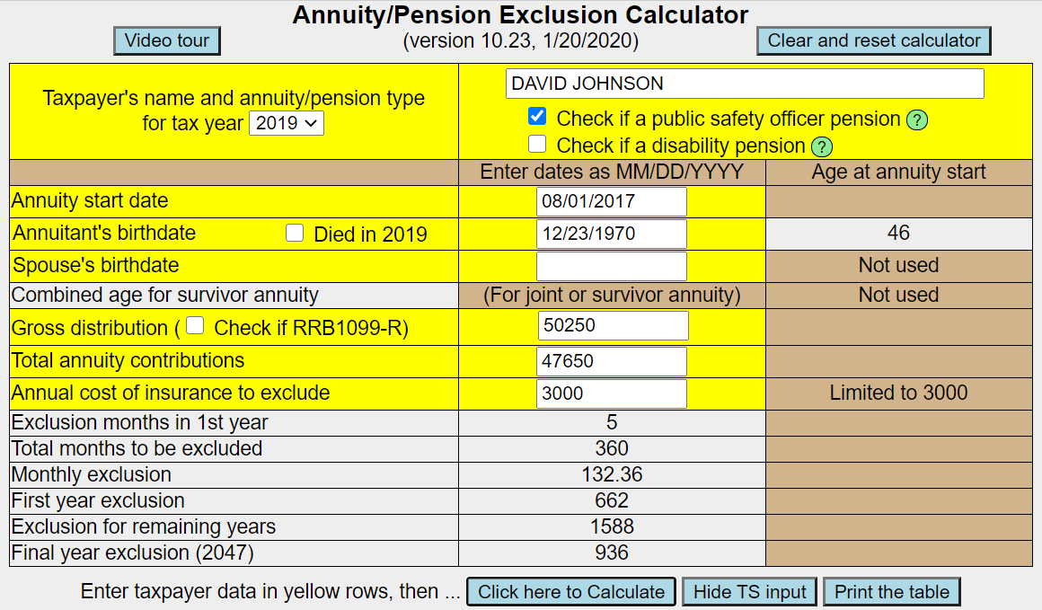
Bogart Annuity Calculator Results for David Johnson – Part 1 Entering $3,000 as PSO Health Insurance Premiums

Slide 17
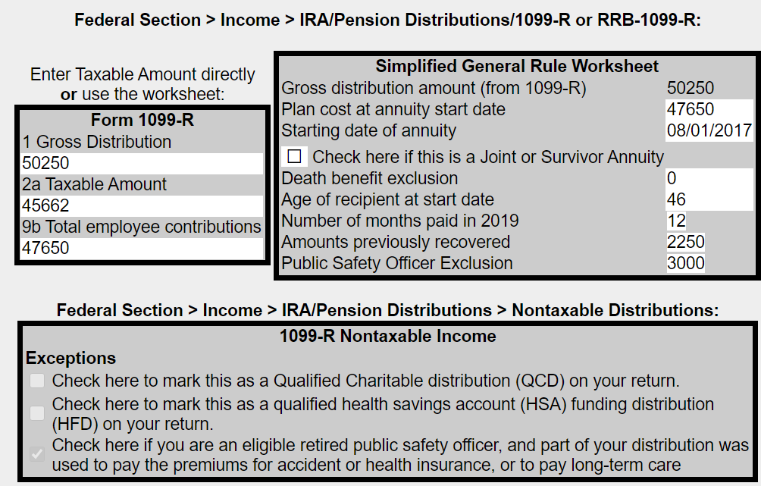
Bogart Annuity Calculator Results for David Johnson – Part 2
Gross distribution (Box 1) $50,250
Exclude:
Recovery of contributions 1,588
PSO premiums 3,000
Taxable amount (Box 2a) $45,662

Slide 18
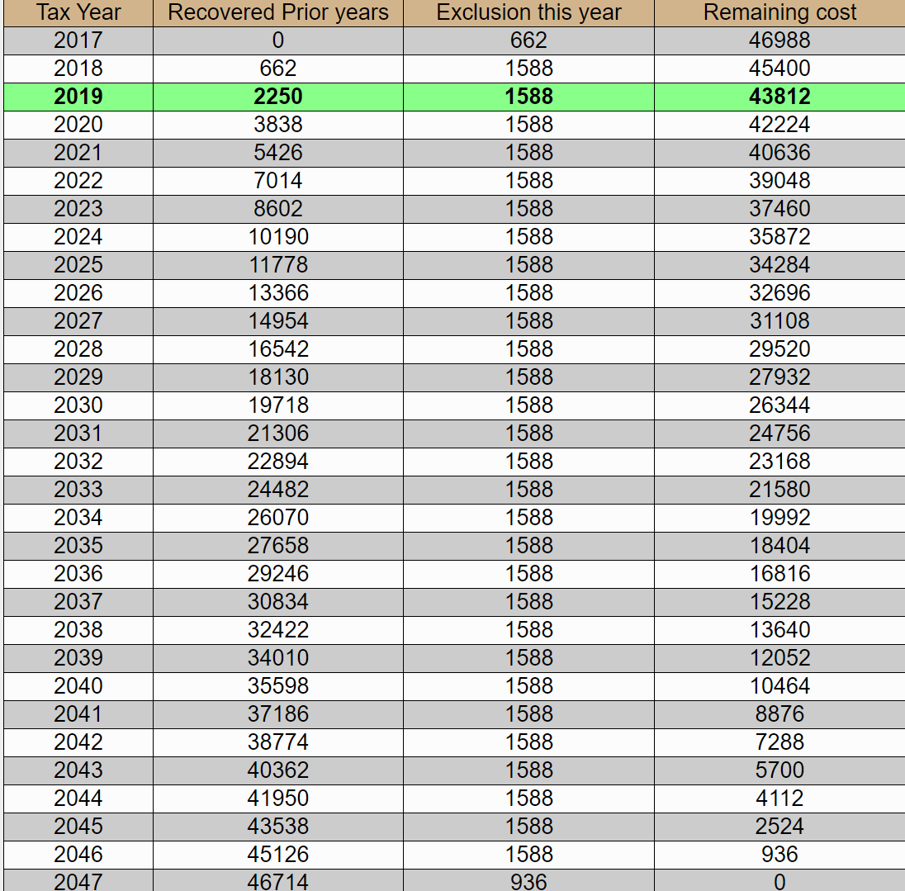
Bogart Annuity Calculator Results for David Johnson – Part 3

